Slide 1

SOLID PROPULSION PROGRESS REPORT: WEEKS 1 & 2

Slide 2
Week 1 Objectives
Orientation
Go through the theory of solid motors
Help in N3.5 launch preparation
Understand N3.5 propulsion system

Slide 3
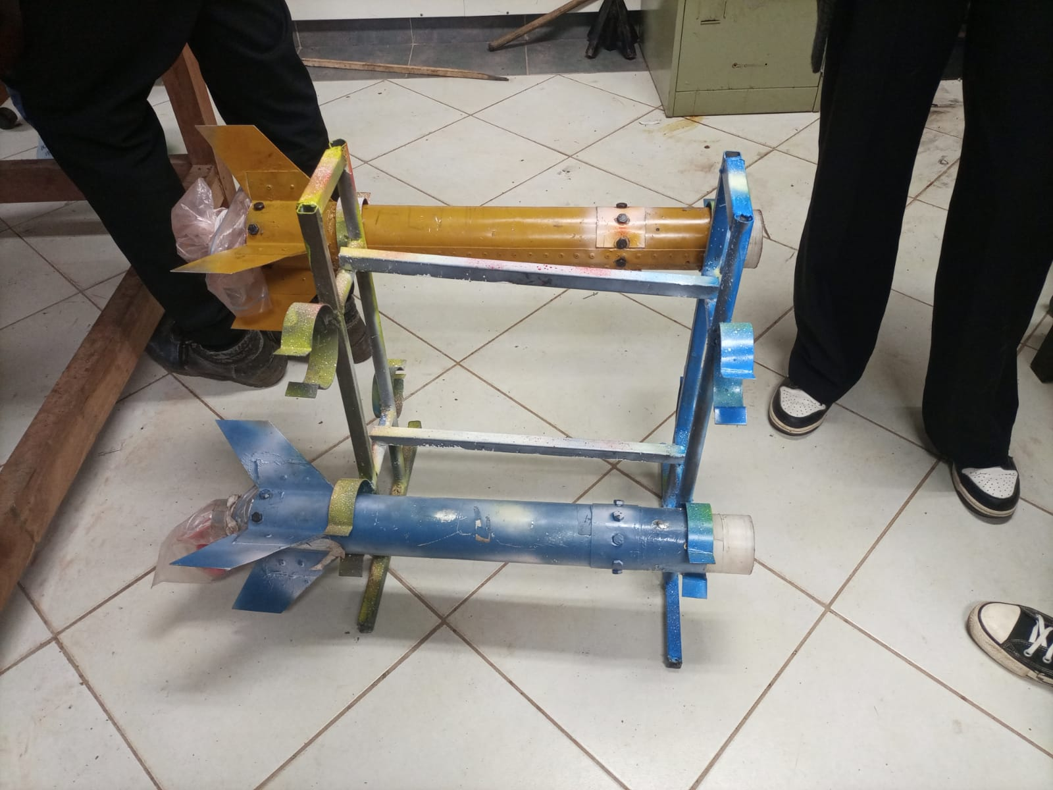
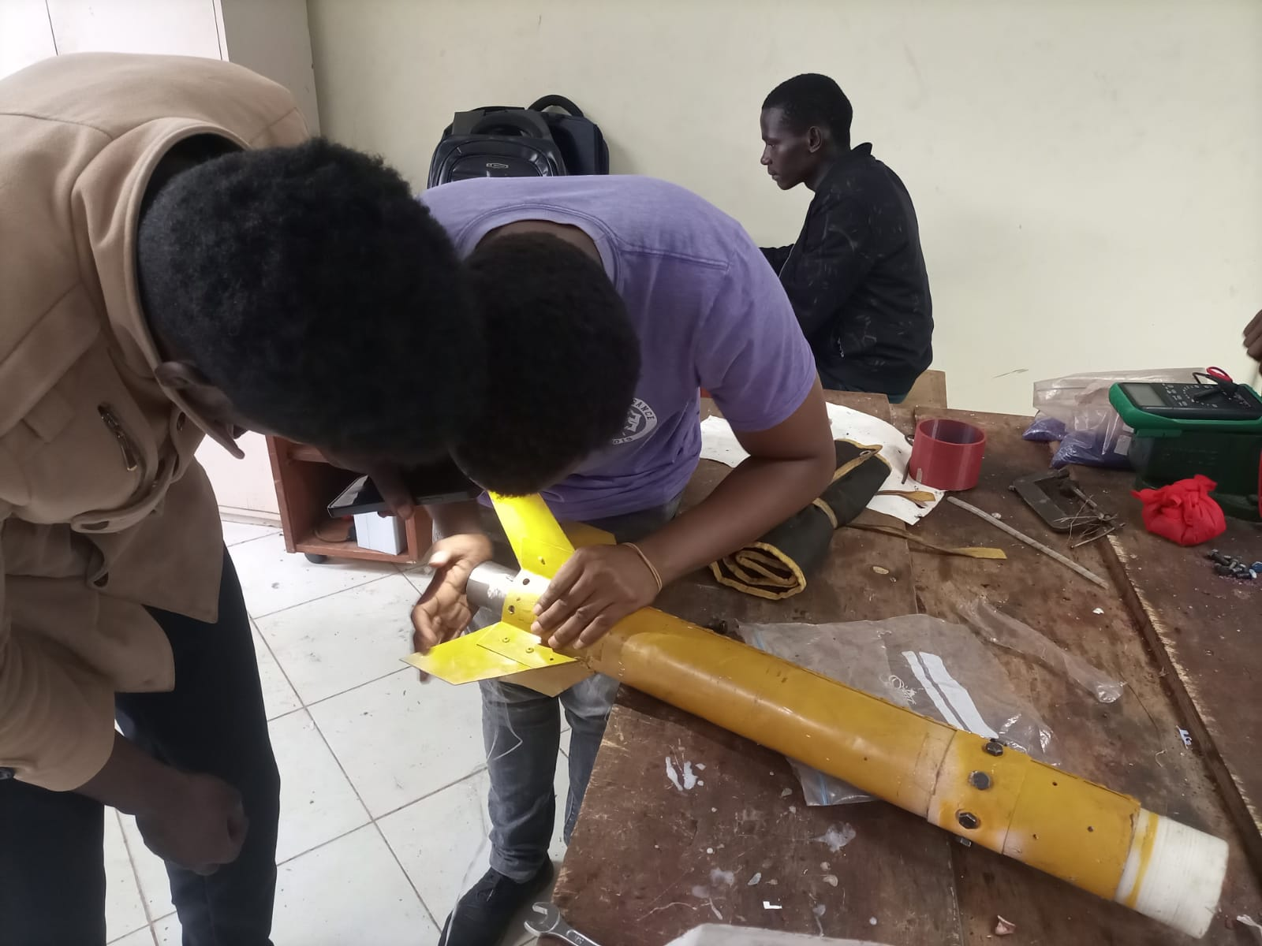
Tasks completed in week 1
Attending orientation meetings
Reading solid motor theory - Richard Nakka
Helped N3.5 team prepare for launch
Installation and training on necessary software - Solidworks, Open Motor, Ansys, etc
Solid propulsion system characterization for N3.5

Slide 4
Week 2 Objectives
Benchmarking solid motor designs
Estimation of required impulse for target apogee
Casing Design
Design of grains and nozzle parameters using Open Motor
Ansys Simulation of flow through nozzle
Design of grain casting tools
Improvements and SA Cup Requirements
Design of Casting Tools

Slide 5
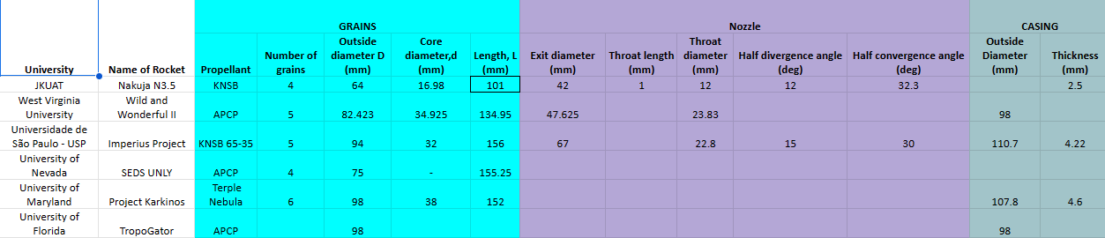
Tasks Completed in week 2
Benchmarking of SRM designs

Slide 6
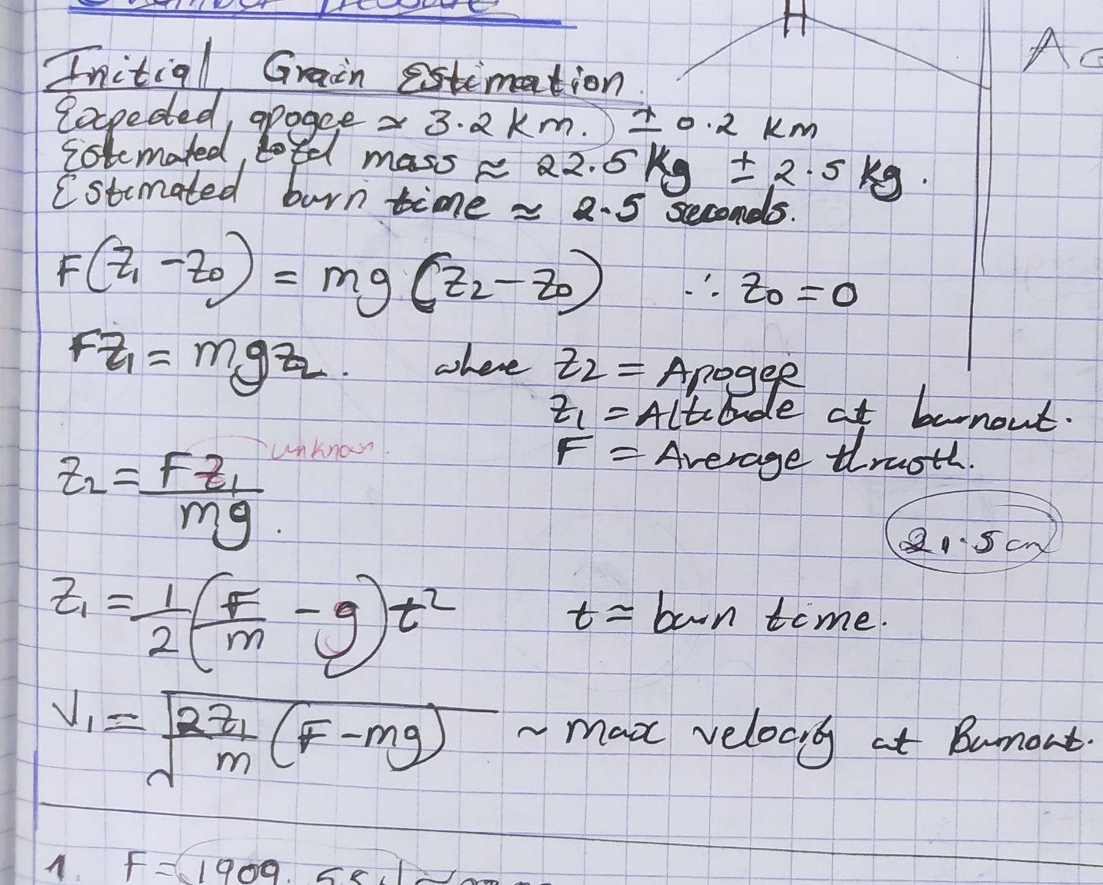
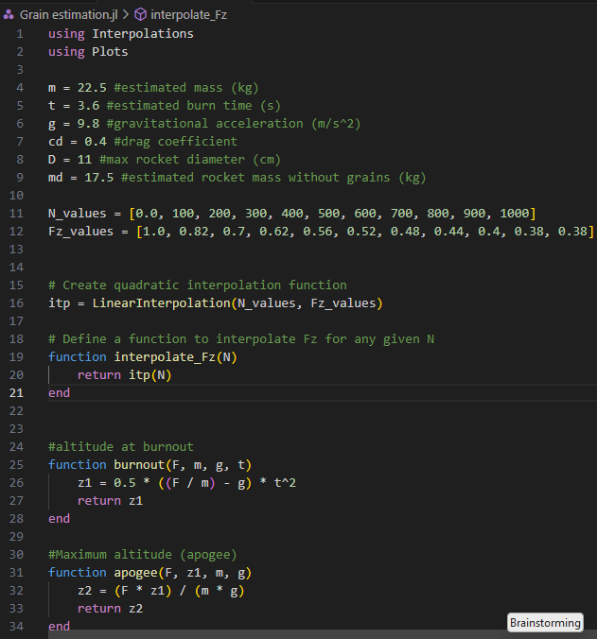
Impulse estimation
Utilization of work-energy equations

Slide 7
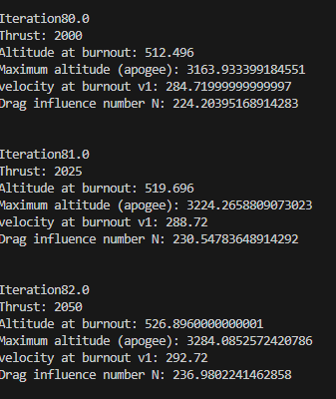
Apogee Estimation Results
Burn time (estimate) = 3.6 s
Avg thrust required = 2025 N
Impulse required = 7290 Ns

Slide 8
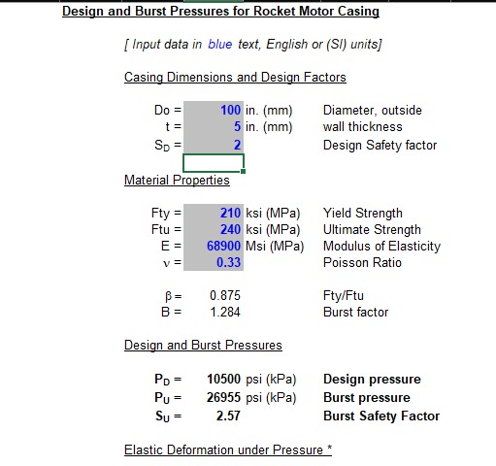
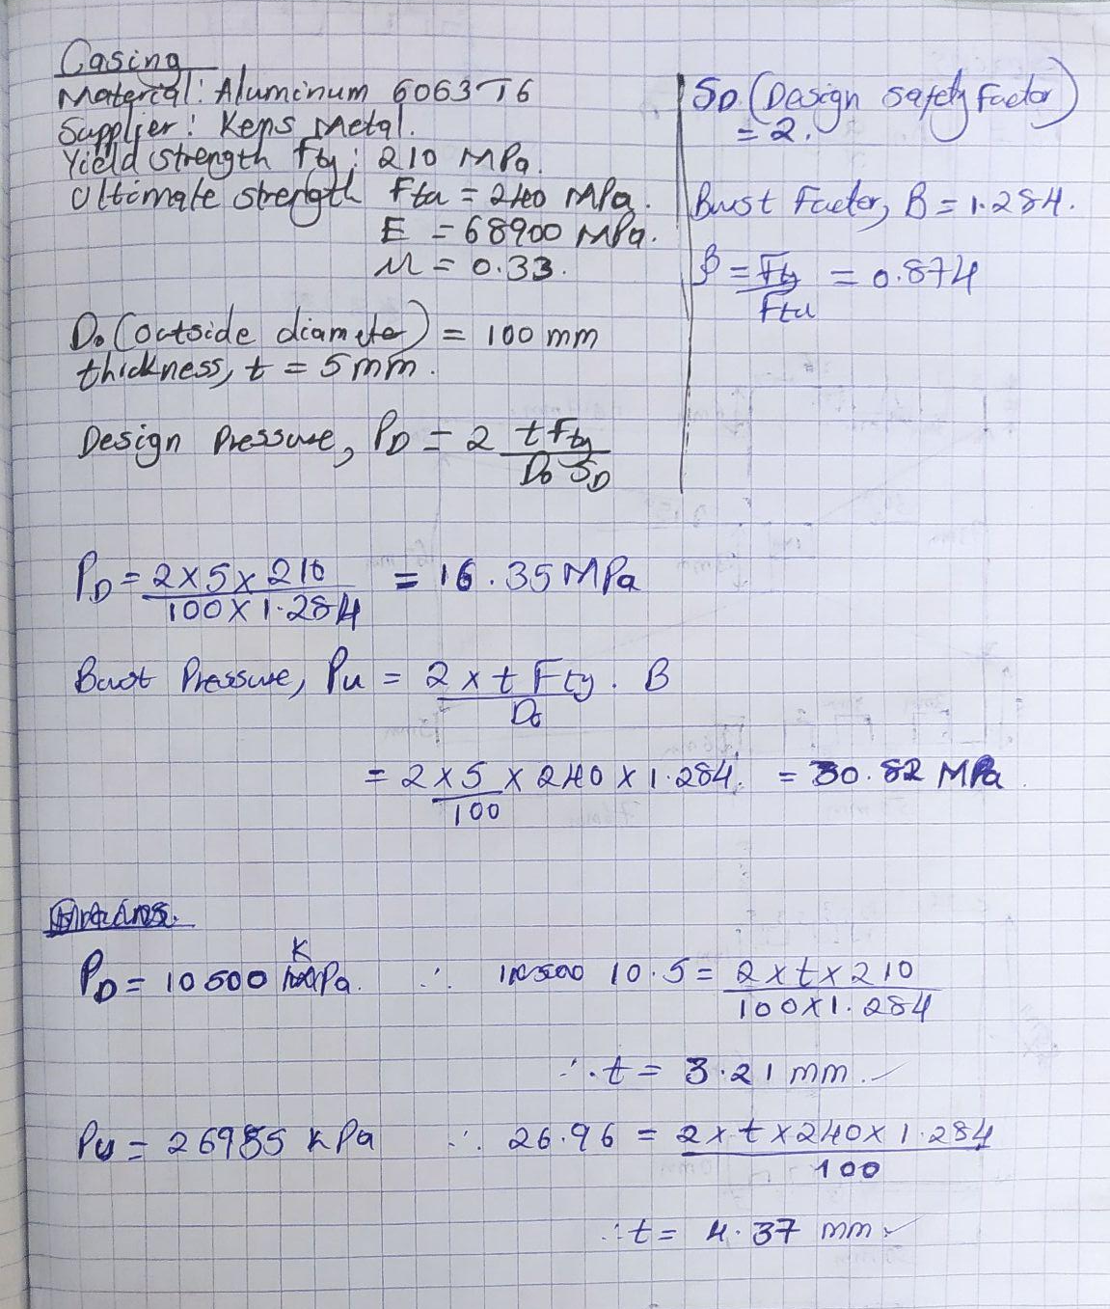
Casing Design
Aluminum 6063 T6

Slide 9
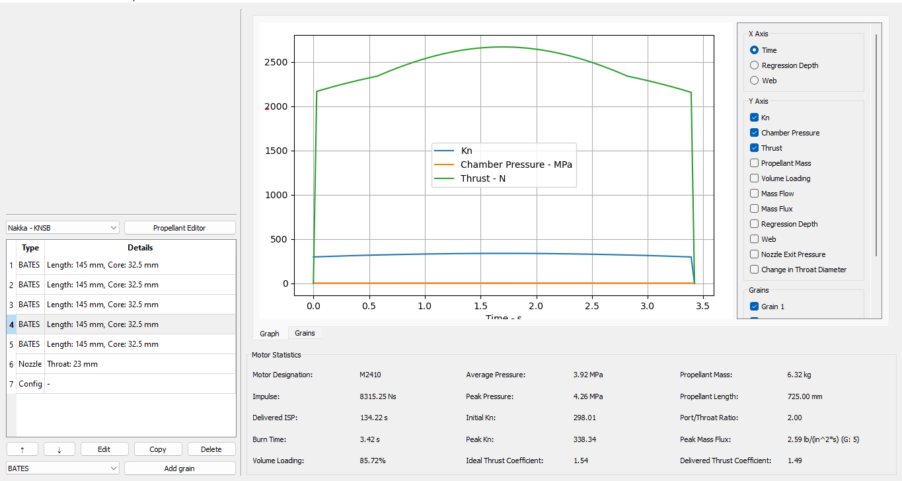
Design of Grains and Nozzle Parameters

Slide 10
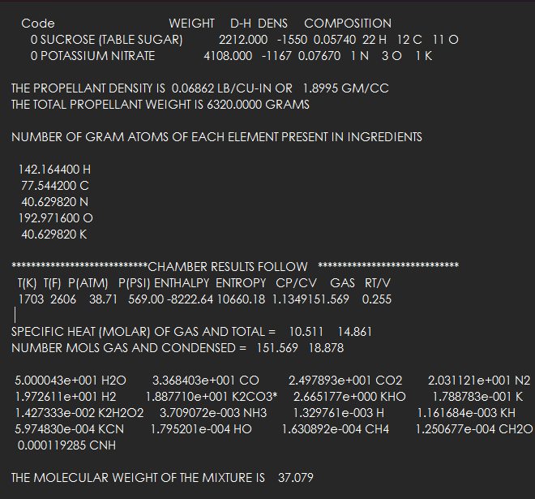
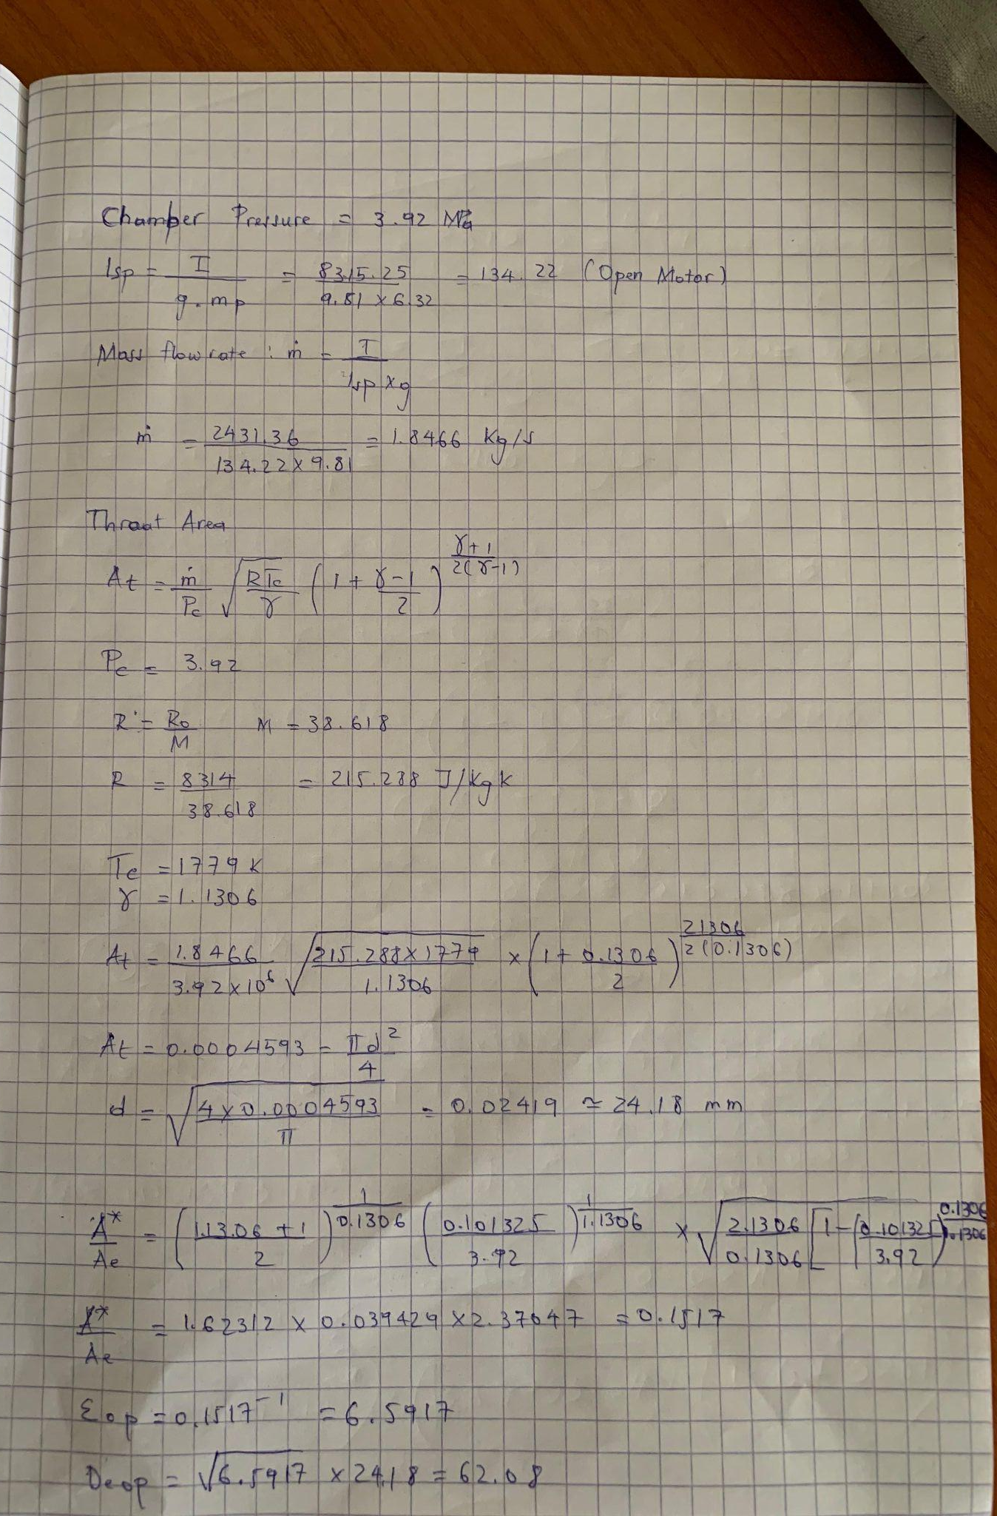
Design of Grains and Nozzle Parameters

Slide 11
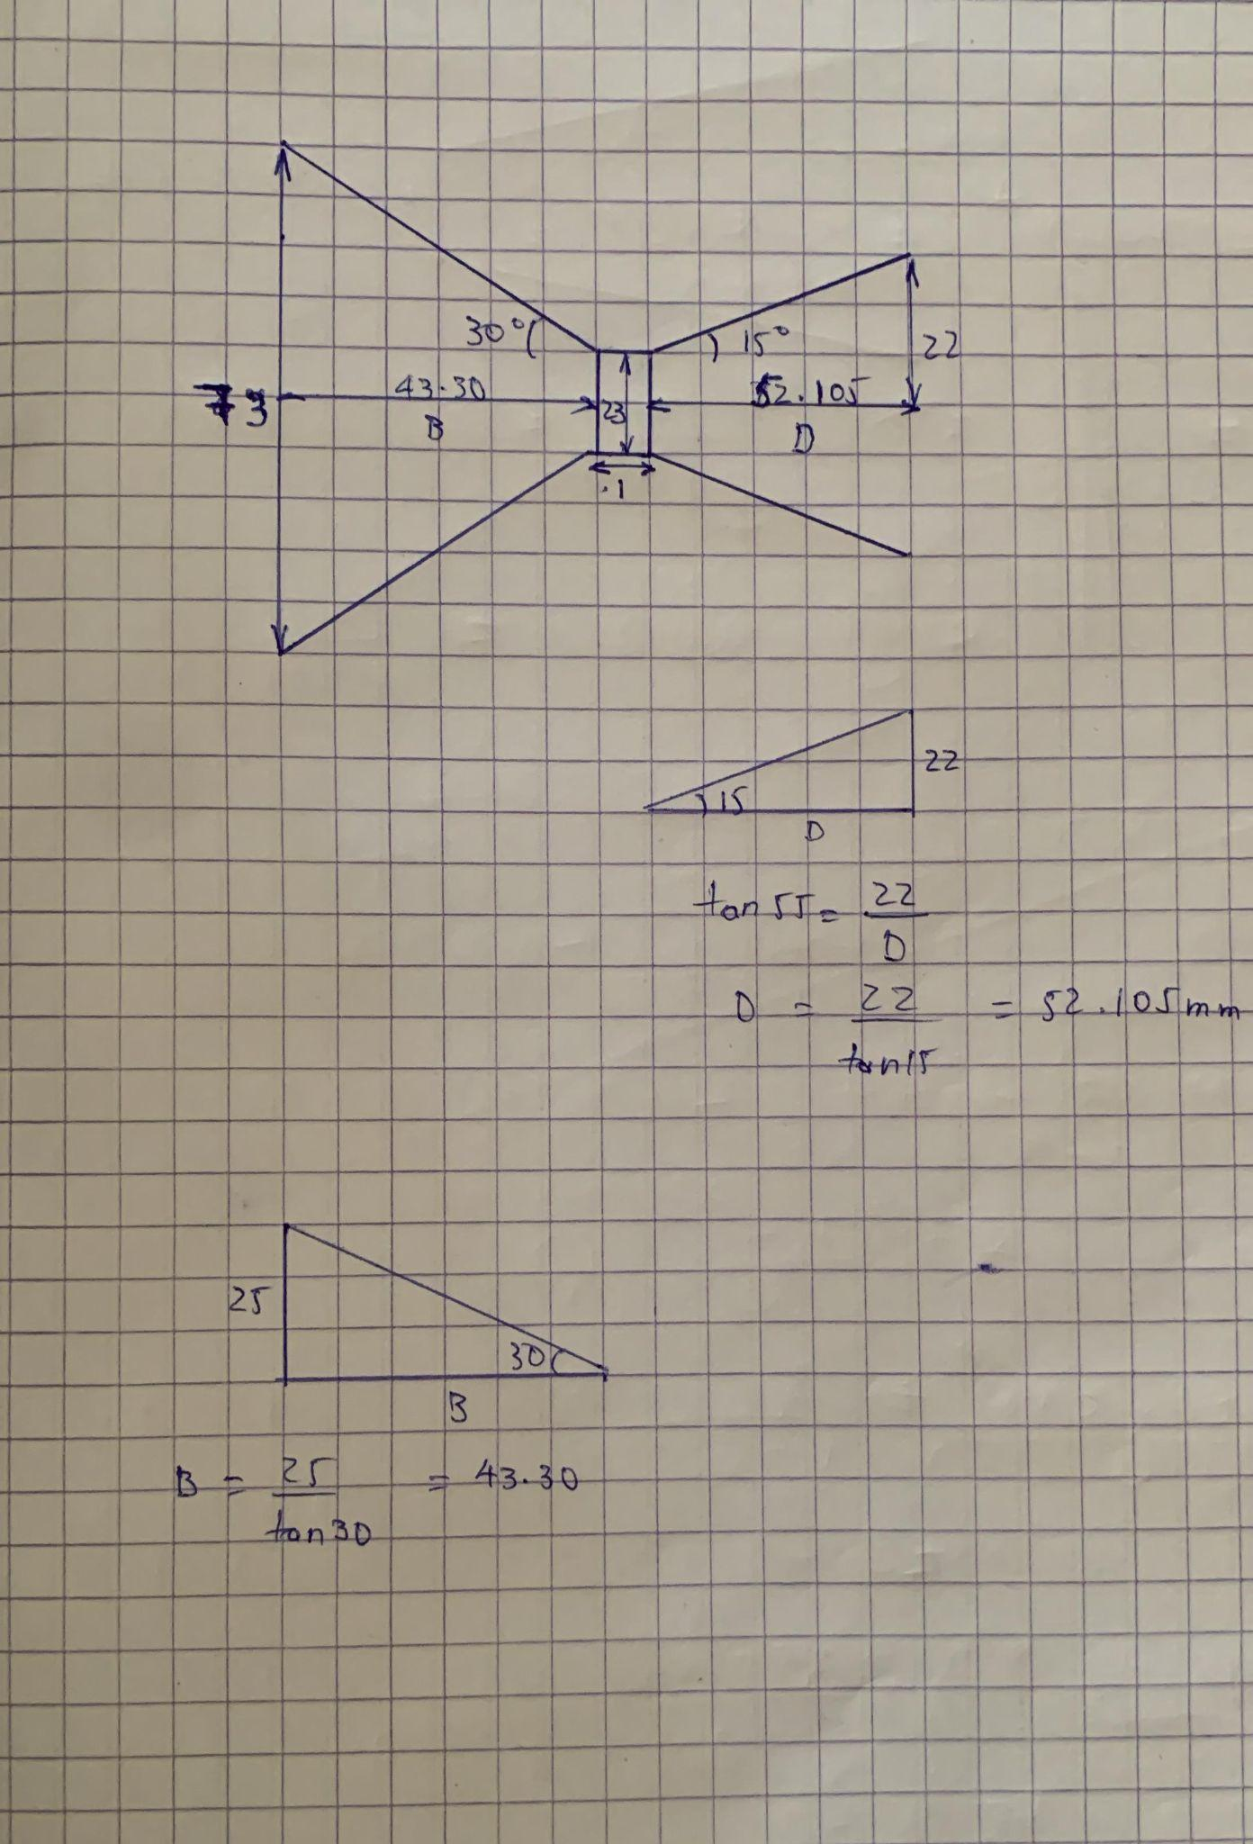
Design of Grains and Nozzle Parameters

Slide 12
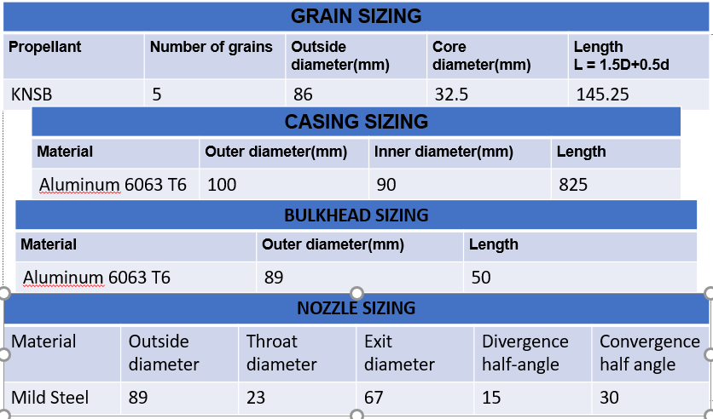
Motor dimensions estimation

Slide 13
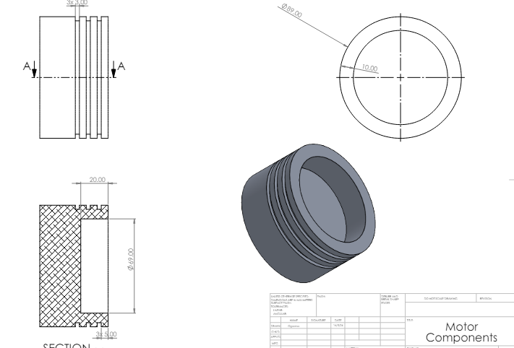
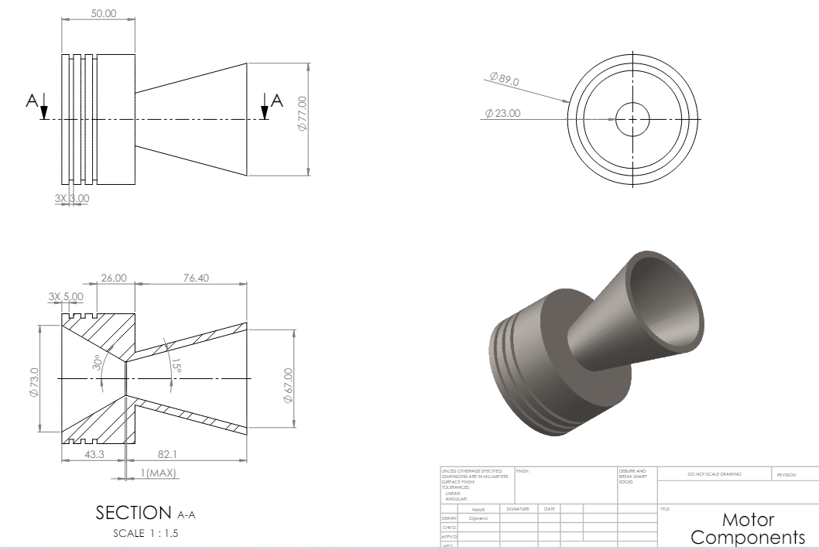
Bulkhead and Nozzle drawing

Slide 14
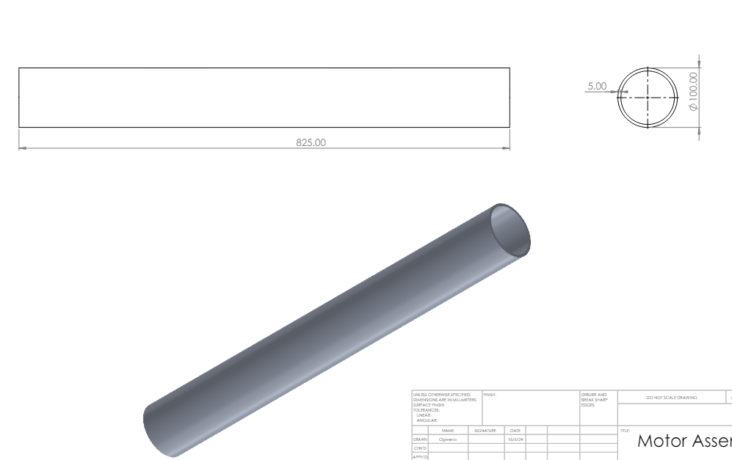
Casing drawing

Slide 15
Recommendations on N3.5 and SA Cup Requirements
SA Cup Requirements
SA Cup Requirements - Google Docs
Recommendations
Measuring chamber pressure and temperature
Measuring casing temperature
Redesign of test stand
Long storage and drying of grains
Challenges
Simulation softwares
Unergonomic seats

Slide 16
Next Week’s Objectives
Nozzle simulation (Ansys) and characterization
Coming up with a components budget
Procurements of casing, nozzle and bulkhead materials
Test stand design
Research on grain storage
Design and 3D printing of Casting tools

Slide 17


